Slide 1
MAHI MISTRY MENTOR – Mr. MUNNA PANDEY
AUTOMOBILE MARKET ANALYSIS PROJECT
PART I & II

Slide 2
AUTOMOBILE MARKET ANALYSIS PROJECT PART - I

Slide 3
Q1. Identify the top 10 cars with highest per gallon. Also identify the name of the cars manufacture. (Task 1)
Model | (All)
Row Labels | Count of City Mileage km litre
Mahindra | 93
Suzuki | 92
Hyundai | 68
Toyota | 62
Tata | 48
Skoda | 30
Renault | 28
Volkswagen | 16
BMW | 16
Ford | 5
Grand Total | 458
Interpretation: This bar graph show the top 10 cars with highest miles gallon based on displacement with their name and car manufacturers.

Slide 4
Q2. Identify the top 3 manufacturers with highest number of cars of the hatchback body type. (Task 3)
Body Type | Hatchback
Row Labels | Count of Model
Suzuki | 96
Hyundai | 46
Tata | 36
Grand Total | 178
Interpretation: This bar will show the Top 3 manufactures with the highest number of cars of hatchback body type. The top 3 cars are Ford, Hyundai and Mahindra car.

Slide 5
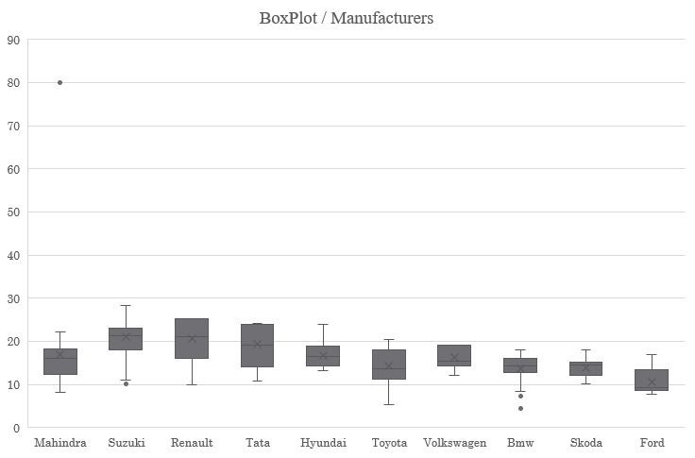
Q3. Compare the mileages of cars produced by all manufacturers and perform outlier analysis. (Task 4)
Make | City Mileage km litre
Mahindra | 80
Mahindra | 80
Suzuki | 28.4
Suzuki | 28.4
Suzuki | 28.4
Suzuki | 28.4
Suzuki | 28.4
Suzuki | 28.4
Suzuki | 28.4
Suzuki | 28.09
Suzuki | 28.09
Suzuki | 28.09
Suzuki | 28.09
Suzuki | 27.39
Suzuki | 27.39
Suzuki | 27.39
Suzuki | 27.39
Suzuki | 26.82
Suzuki | 26.32
Suzuki | 26.32
Renault | 25.17
Renault | 25.17
Renault | 25.17

Slide 6
Renault | 25.17
Renault | 25.17
Renault | 25.17
Renault | 25.17
Renault | 25.17
Renault | 25.17
Renault | 25.17
Renault | 25.17
Renault | 25.17
Tata | 24.12
Tata | 24.12
Tata | 24.12
Tata | 24.12
Tata | 24.12
Tata | 24.12
Hyundai | 24
Hyundai | 24
Tata | 23.84
Tata | 23.84
Tata | 23.84
Tata | 23.84
Tata | 23.84
Tata | 23.84
Tata | 23.84
Suzuki | 23.65
Suzuki | 23.65
Suzuki | 23.65
Suzuki | 23.65
Tata | 23.6
Tata | 23.6
Tata | 23.6
Tata | 23.6
Tata | 23.6
Suzuki | 23
Suzuki | 23
Suzuki | 23
Suzuki | 23
Suzuki | 23
Suzuki | 23
Suzuki | 23
Suzuki | 23
Suzuki | 23
Suzuki | 23
Suzuki | 23
Suzuki | 23
Suzuki | 23
Suzuki | 23
Suzuki | 23
Suzuki | 23
Suzuki | 23
Suzuki | 23
Suzuki | 23
Tata | 22.95
Tata | 22.95
Tata | 22.95
Tata | 22.95
Mahindra | 22.25
Mahindra | 22.25
Mahindra | 22.25
Mahindra | 22.25
Mahindra | 22.25
Mahindra | 22.25
Mahindra | 22.25
Mahindra | 22.25
Mahindra | 22.25
Mahindra | 22.25
Mahindra | 22.25
Suzuki | 21.56
Suzuki | 21.4
Suzuki | 21.4
Suzuki | 21.4
Suzuki | 21.4
Suzuki | 21.4
Suzuki | 21.4
Suzuki | 21.4
Interpretation: This Box Plot shows the comparison between city milage of cars and all manufacturers. So we get the outlier in Mahindra manufacturers company.

Slide 7
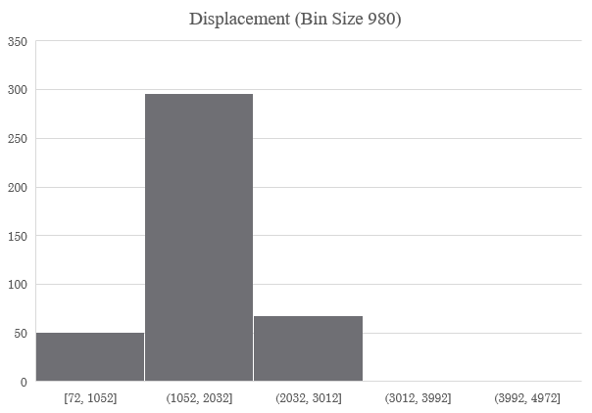
Q4. Identify the Outliers from following columns using Histogram method. 1) Displacement (Bin Size = 980) 2) City Mileage (miles / gallon)(Bin Size = 0.88) 3)Fuel Tank Capacity (Bin Size = 3) Remove the identified outliers from the dataset. (Task 9)
Displacement
Q1 | Q3 | IQR | LF | UF
1197 | 1591 | 394 | 606 | 2182
Mileage
Q1 | Q3 | IQR | LF | UF
14 | 20.89 | 6.89 | 3.665 | 31.225
Fuel Tank
Q1 | Q3 | IQR | LF | UF
37 | 60 | 23 | 2.5 | 94.5

Slide 8
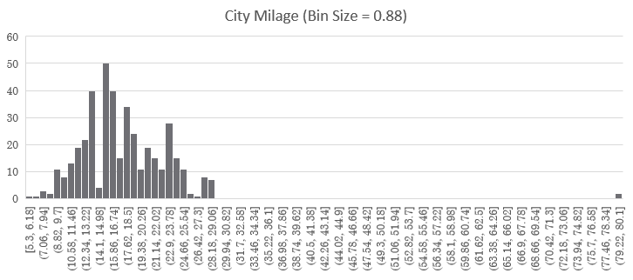
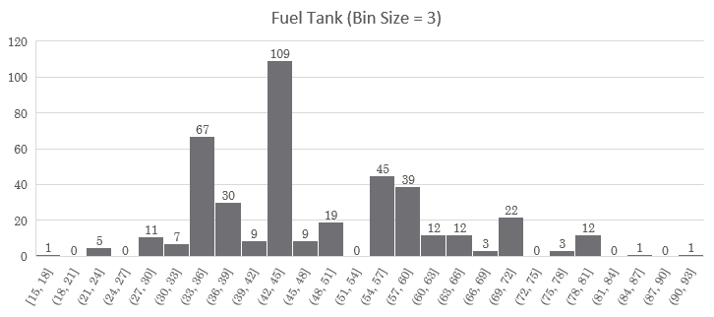
Interpretation: Here, After identifying the all 3 daigram shows the values of removed Outliers by using IF FUNCTION in (Displacement, Fuel Capacity and City Mileage) the dataset in below slide.
This histogram shows the Displacement with bin size =980,
City Mileage with bin size = 0.88,
Fuel Tank with bin size
= 3

Slide 9
This is the dataset which we used to remove the outliers.
Outliers (Disp) | Outliers (Mile) | Outliers (Fuel) | Displacement | City_Mileage | Fuel_Tank_Capacity
No | Yes | No | 1248 | 80 | 37
Yes | Yes | Yes | 1248 | 80 | 37
No | No | Yes | 1248 | 28.4 | 37
Yes | No | Yes | 1248 | 28.4 | 37
Yes | Yes | Yes | 1248 | 28.4 | 37
No | Yes | Yes | 1248 | 28.4 | 37
Yes | Yes | Yes | 1248 | 28.4 | 37
Yes | Yes | Yes | 1248 | 28.4 | 43
Yes | Yes | Yes | 1248 | 28.4 | 43
Yes | Yes | Yes | 1248 | 28.09 | 43
Yes | Yes | Yes | 1248 | 28.09 | 43
Yes | Yes | Yes | 1248 | 28.09 | 37
Yes | Yes | Yes | 1248 | 28.09 | 37
Yes | Yes | Yes | 1248 | 27.39 | 37
Yes | Yes | Yes | 1248 | 27.39 | 37
Yes | Yes | Yes | 1498 | 27.39 | 43
Yes | Yes | Yes | 1498 | 27.39 | 43
Yes | Yes | Yes | 1498 | 26.82 | 43
Yes | Yes | Yes | 799 | 26.32 | 28
Yes | Yes | Yes | 799 | 26.32 | 28
Yes | Yes | Yes | 799 | 25.17 | 28
Yes | Yes | Yes | 799 | 25.17 | 28
Yes | Yes | Yes | 999 | 25.17 | 28
Yes | Yes | Yes | 999 | 25.17 | 28
Yes | Yes | Yes | 999 | 25.17 | 28
Yes | Yes | Yes | 999 | 25.17 | 28
Yes | Yes | Yes | 999 | 25.17 | 28
Yes | Yes | Yes | 999 | 25.17 | 28
Yes | Yes | Yes | 999 | 25.17 | 28

Slide 10
Q5. Find the most popular car body type, by count, from the analysis of (task 2). Car body type can fall under the categorical such as SUV, Sedan, and Hatchback. (Task 11)
Row Labels | Count of Body_Type
Hatchback | 263
SUV | 223
Sedan | 223
Grand Total | 709
Interpretation: This will give you the count of each car body type (SUV, Sedan, Hatchback) and allow you to easily identify the most popular one. From this table, you can see which car body type has the highest count and thus is the most popular.

Slide 11
AUTOMOBILE MARKET ANALYSIS PROJECT PART - II

Slide 12
Q1. Identify the top two manufacturers who offer the widest range of cars variants, Use appropriate chart/graphs to present the output, capturing the number of car variants under each body type for the two manufacturers identified above. (Task 1)
 | (Multiple Items)
Row Labels | Count of Variant
Suzuki | 163
Hyundai | 130
Mahindra | 118
Tata | 100
Toyota | 82
Ford | 43
Skoda | 43
Renault | 36
Bmw | 35
Volkswagen | 34
Grand Total | 784
Interpretation: This Bar show the top manufacturers who offers the widest range of car variant. The 1st manufacturers is Suzuki (163 variant) and 2nd manufacturer is Hyundai (130 variants) in all the body type.

Slide 13
Q2. Calculate and compare variations between city mileage data using different measures of dispersion of the following three manufacturers. (Task 2) 1) Tata 2) Maruti Suzuki 3) Hyundai Which manufacturer offers the widest variation of city mileage?
City_Mileage_km_litre | (All)
Row Labels | Count of Variant
Tata | 100
Hyundai | 130
Suzuki | 163
Grand Total | 393
Interpretation: This bar show the comparison between variants and city milage but measure of dispersion (finding the average) of all the manufactures. Maruti Suzuki giver the widest variation of city milage.

Slide 14
Q3. (Task 3) A) Display and check how City mileage depends on Fuel Tank Capacity using scatter plot along with trend line and Person’s product-moment co-efficiency (R).
City_Mileage_km_litre | Fuel_Tank_Capacity_litre
23.6 | 24
23.6 | 24
0 | 15
23.6 | 24
23.6 | 24
23.6 | 24
25.17 | 28
25.17 | 28
25.17 | 28
25.17 | 28
25.17 | 28
25.17 | 28
25.17 | 28
25.17 | 28
25.17 | 28
25.17 | 28
25.17 | 28
25.17 | 28
Interpretation: The slope is very close to zero, indicating that changes in fuel tank capacity have a negligible effect on city mileage. value is 0.0045, which means that the fuel tank capacity explains only about 0.45% of the variance in city mileage. This confirms that there is no significant linear relationship between the two variables.

Slide 15
Q3. (Task 3) B) Display and check how Displacement depends on Fuel Tank Capacity using scatter plot along with trend line and Person’s product-moment co-efficiency (R).
Fuel_Tank_Capacity_litre | Displacement
24 | 624
24 | 624
15 | 624
24 | 624
24 | 624
24 | 624
28 | 799
28 | 799
28 | 799
28 | 799
28 | 999
28 | 999
28 | 999
28 | 999
28 | 999
28 | 999
28 | 999
28 | 999
Interpretation: This Scatterplot slope shows the positive correlation between Displacement and fuel tank capacity where R=0.76

Slide 16
Q4. Data Analysis (Task 4b) B) Convert categorical variable to numerical codes (Ex. Petrol = 1, Diesel = 2, Electric = 3, CNG = 4, CNG + Petrol = 5)
Fuel_Type | Value
Petrol | 1
Petrol | 1
CNG | 4
Petrol | 1
Petrol | 1
Petrol | 1
Petrol | 1
Petrol | 1
Petrol | 1
CNG | 4
CNG | 4
Petrol | 1
Petrol | 1
Petrol | 1
Petrol | 1
CNG | 4
Petrol | 1
Petrol | 1
CNG | 4
Petrol | 1
Petrol | 1
CNG | 4
Petrol | 1
Petrol | 1
CNG | 4
Petrol | 1
Petrol | 1
Petrol | 1
Converting categorical data into numerical codes is a crucial step in data preprocessing for analysis and modelling.
The formula provided helps automate this process in Excel, ensuring each category is consistently represented by a unique number.
This conversion facilitates efficient data analysis, visualization, and application of various statistical and machine learning techniques.
=IF(B3="CNG", 4, IF(B3="Petrol", 1, IF(B3="Electric", 3, IF(B3="Diesel", 2, IF(B3="CNG + Petrol", 5,"")))))

Slide 17
Q4. Data Analysis (Task 4b) C)Standardize the Unit.
Displacement | Fuel_Tank_Capacity_litre | Ground_Clearance
1248 | 37 | 170
1248 | 37 | 170
1248 | 37 | 163
1248 | 37 | 163
1248 | 37 | 163
1248 | 37 | 163
1248 | 37 | 163
1248 | 43 | 163
1248 | 43 | 163
1248 | 43 | 170
1248 | 43 | 170
1248 | 37 | 170
1248 | 37 | 170
1248 | 37 | 170
1248 | 37 | 170
1248 | 43 | 170
1248 | 43 | 170
1498 | 43 | 170
1498 | 28 | 170
1498 | 28 | 170
799 | 28 | 184
799 | 28 | 184
799 | 28 | 184
799 | 28 | 184
999 | 28 | 184
999 | 28 | 184
999 | 28 | 184
999 | 28 | 184
999 | 28 | 184
Disp(cc to L) | Fuel(L to gallons) | Ground(mm to inches)
1.248 | 9.774364 | 6.692917
1.248 | 9.774364 | 6.692917
1.248 | 9.774364 | 6.4173263
1.248 | 9.774364 | 6.4173263
1.248 | 9.774364 | 6.4173263
1.248 | 9.774364 | 6.4173263
1.248 | 9.774364 | 6.4173263
1.248 | 11.359396 | 6.4173263
1.248 | 11.359396 | 6.4173263
1.248 | 11.359396 | 6.692917
1.248 | 11.359396 | 6.692917
1.248 | 9.774364 | 6.692917
1.248 | 9.774364 | 6.692917
1.248 | 9.774364 | 6.692917
1.248 | 9.774364 | 6.692917
1.248 | 11.359396 | 6.692917
1.248 | 11.359396 | 6.692917
1.498 | 11.359396 | 6.692917
1.498 | 7.396816 | 6.692917
1.498 | 7.396816 | 6.692917
0.799 | 7.396816 | 7.2440984
0.799 | 7.396816 | 7.2440984
0.799 | 7.396816 | 7.2440984
0.799 | 7.396816 | 7.2440984
0.999 | 7.396816 | 7.2440984
0.999 | 7.396816 | 7.2440984
0.999 | 7.396816 | 7.2440984
0.999 | 7.396816 | 7.2440984
0.999 | 7.396816 | 7.2440984

Slide 18
Q5. Data Analysis (Task 5) B) Use Scatter plot and correlation matrices to explore relationships between fuel efficiency and other variables.
Fuel Efficency
Average (combined milage) | Displacement | Wheelbase
31.1 | 624 | 2230 mm
31.1 | 624 | 2230 mm
31.1 | 624 | 2230 mm
32.1 | 624 | 2230 mm
32.1 | 624 | 2230 mm
37.205 | 624 | 2230 mm
33.67 | 1196 | 2350 mm
33.67 | 1196 | 2350 mm
36.67 | 1196 | 2350 mm
36.67 | 1196 | 2350 mm
36.67 | 1196 | 2350 mm
36.67 | 998 | 2360 mm
37.17 | 998 | 2360 mm
37.17 | 998 | 2360 mm
37.17 | 998 | 2360 mm
36.17 | 998 | 2360 mm
36.17 | 998 | 2360 mm
23 | 998 | 2425 mm
23 | 998 | 2425 mm
22 | 1086 | 2400 mm
25 | 1086 | 2400 mm
25 | 1086 | 2400 mm
30 | 1086 | 2400 mm
32.5 | 1086 | 2400 mm
32.5 | 1086 | 2400 mm
33.445 | 1086 | 2400 mm
33.84 | 1086 | 2400 mm
32.695 | 1199 | 2400 mm
Interpretation: The scatter plot suggests that within the given dataset, fuel efficiency does not have a strong linear dependence on engine displacement. Further analysis considering additional variables might be needed to fully understand the factors influencing fuel efficiency.

Slide 19
PART 1
SUMMARY
Top Cars: Identifies the top 10 cars with the best miles per gallon (MPG) by displacement and manufacturers.
Body Type Leaders: Highlights manufacturers with the most hatchback models, with Ford, Hyundai, and Mahindra leading.
City Mileage Insights: Uses box plots to compare mileage across manufacturers and identify outliers (e.g., Mahindra).
Performance Relationships: Shows a negative correlation between city mileage and displacement, and no significant link between city mileage and fuel tank capacity.
Adventure Cars: Identifies models with the best ground clearance and engine power for off-road use.
Family Cars: Provides insights for selecting cars suitable for family needs.
Competitor Analysis: Visualizes potential rival cars in compact city and family segments.
Body Type Popularity: Highlights the count of SUVs, sedans, and hatchbacks to identify the most popular categories.

Slide 20
PART 2
SUMMARY
Manufacturer Variants: Suzuki and Hyundai offer the widest range of variants across body types.
Mileage Variation: Maruti Suzuki exhibits the widest variation in city mileage.
Performance Correlations: Minimal impact of fuel tank capacity on mileage; a positive correlation between displacement and fuel tank capacity.
Categorical Data Processing: Converts data to numerical codes for better analysis and modeling.
Fuel Efficiency Insights: Categorizes cars into high, moderate, and low efficiency, identifying key traits of high-efficiency models for better consumer and business decisions.

Slide 21
THANK YOU

